Slide 1



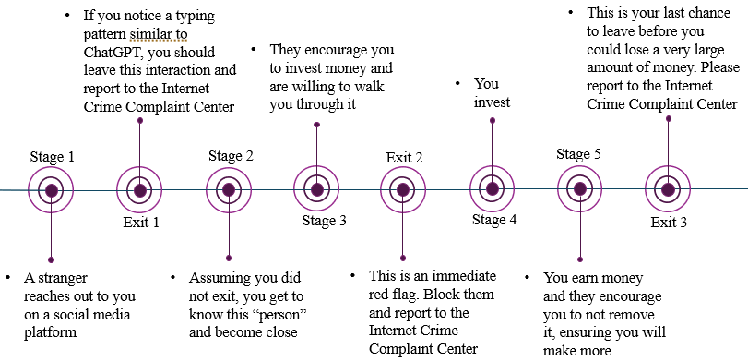
A Systematic Approach to Countering Cybercrime Using AI Tools
Author: Emma K Scott
Advisor: Dr. Aloysius Bathi Kasturiarachi
Kent State University at Stark
ABSTRACT
PSEUDOCODE FOR SOFTWARE PROGRAM
The research project will focus on deriving methods that use AI tools to detect cybercrimes before and during the activity and mitigate preventative actions. We will analyze cybercrimes linked to:
1. deepfakes
2. money laundering and financial crime
3. disinformation.
With explosive development of high-throughput technologies, high-dimensional online data are commonly observed in many fields. Examples include real-time monitoring for sensor networks, computer network anomaly detection and threat detection from surveillance videos. Analyzing online time series data provides timely snapshots of the monitored system and thus allows for real-time anomaly detection. Due to dynamic behavior of monitored systems, the observed online data often involve sudden changes. We will use AI Tools to detect sudden changes in data as well as triggers to identify deepfakes.
Set written to W
Set video to V
Set accuracy to A
Set average to x = W + V + A
Set score to x * 100
If deepfake is spoken with image
Check for red flag imagery or audio
For each imagery red flag found add 0.1 to V
For each audio red flag found add 0.1 to A
Else
Check for red flag writing
For each red flag found add 0.1 to W
Average
Print score
If score = 0 or score > 0 and score < 61
Print “Possible AI detected. Proceed with caution”
Else
Print “No AI detected”
SOLUTIONS
The rapid advancement of AI, along with the public’s access to it, has contributed to a steady, significant increase in the number of cybercrimes being committed. As AI continues to progress, it becomes increasingly difficult to identify AI-generated content, which makes it harder to prevent digital crimes. We have found multiple solutions that, together, will crack down on cybercrime.
Education. Encouraging skepticism and guiding the public’s recognition of AI-produced disinformation, deepfakes, and cybercrime are the most crucial elements needed for prevention.
Laws. Issuing a law that requires users uploading AI-generated content to social media platforms to include either a watermark or a statement acknowledging the use of AI will cut down on the spread of disinformation.
Software programs. Access to free, accurate software that automatically detects the use of AI in text, linear and interactive videos, and photos may become essential as AI continues to advance.
FINANCIAL SCAM TIMELINE
CONCLUSION
While the concept of cybercrime is nothing new, the implementation of AI in crime certainly is, and it is because of this that we must discontinue the use of unregulated AI. It is not unrealistic to assume that digital crime will become more serious if we continue to ignore.
REFERENCES
“FBI: Cybercrime losses increased 26% in 2025.” ABA Banking Journal, April 7, 2026.
“Welcome to the Internet Crime Complaint Center.” ic3.gov.

